Slide 1
USER GUIDE | FULLSTACK + QA AUTOMATION ASSESSMENT
EMI
EMI Calculator
Plan a loan. Prove every number.
Dashboard, report, compare and eligibility tools, with 194 automated test scenarios behind them.
PLAN | COMPARE | VERIFY
User guide | 15 Oct 2026
Notes:
Cover. This guide walks through the EMI Calculator app screen by screen, then shows the automated tests, API checks, SQL queries and self-healing proof of concept that support it.

Slide 2
The User Journey, Screen by Screen
USER JOURNEY
01
Dashboard
10
Saved scenarios & sharing
HOW TO USE IT
Read the guide in order: eleven app screens first, then six slides on how the app is tested.
02
Loan types & timing
11
Dark mode
03
Prepayment
12
Test suites
04
Insights & affordability
13
HTML test report
05
Cumulative chart
14
API tests
06
Report & drill-down
15
SQL: round-trip transfers
WHAT YOU GET
A map of every screen, so each slide that follows has clear context.
07
Financial year & filters
16
SQL: IPL streaks
08
Compare loans
17
AI self-healing
09
Eligibility
Notes:
Contents map. Blue numbers are app screens; teal numbers are the testing, API, SQL and self-healing slides.

Slide 3
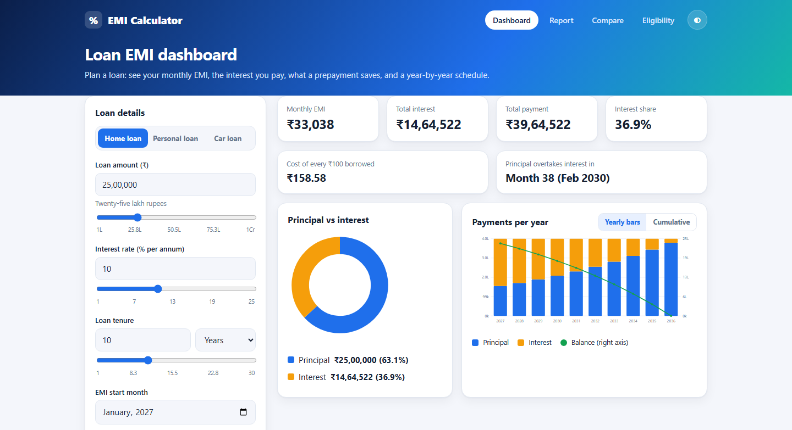
The dashboard turns a loan into numbers you can act on
01 / DASHBOARD
HOW TO USE IT
Enter amount, rate and tenure on the left. Results update as you type or drag a slider.
WHAT YOU GET
Monthly EMI, total interest and payment, a principal-vs-interest pie, and yearly bars with a balance line.
Notes:
Default loan: 25 lakh at 10% for 10 years gives an EMI of 33,038. Everything on this screen recalculates live.

Slide 4
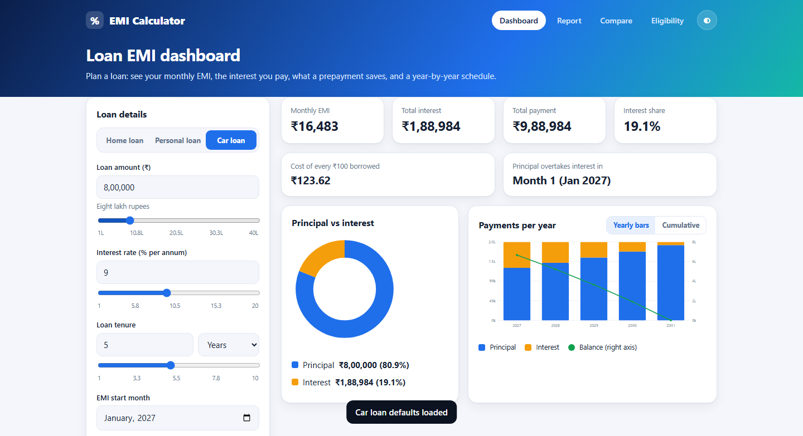
Loan types and payment timing change the maths instantly
02 / LOAN TYPES & TIMING
HOW TO USE IT
Pick Home, Personal or Car loan for matching defaults and slider ranges. Choose EMI at the start or end of the month.
WHAT YOU GET
Start-of-month payments lower the EMI and the total interest, and every figure recalculates.
Notes:
Each loan type has its own starting values and slider range. Paying at the start of the month divides the EMI by one plus the monthly rate.

Slide 5
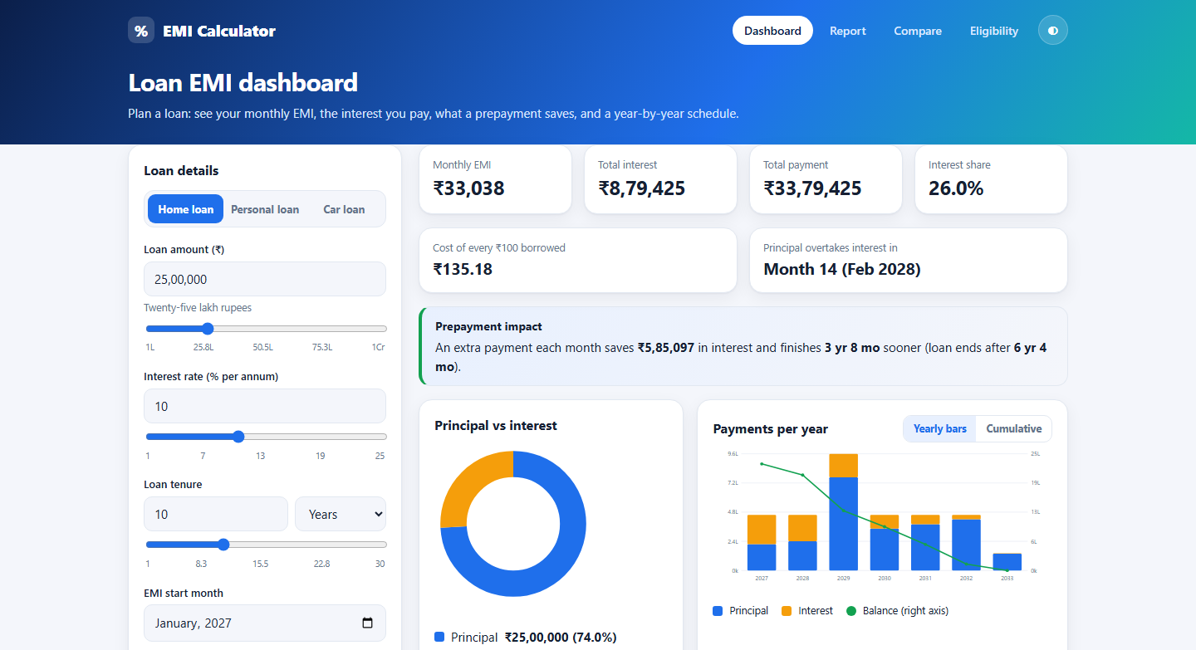
Prepayments show exactly how much time and interest you save
03 / PREPAYMENT
HOW TO USE IT
Add an extra monthly payment, a one-time prepayment, or both, and say after which payment the lump sum is paid.
WHAT YOU GET
A Prepayment impact box shows interest saved, time saved and when the loan now ends.
Notes:
Example: 5,000 extra every month plus 5 lakh after payment 36 ends the loan 3 years 8 months early and saves about 5.85 lakh in interest.

Slide 6
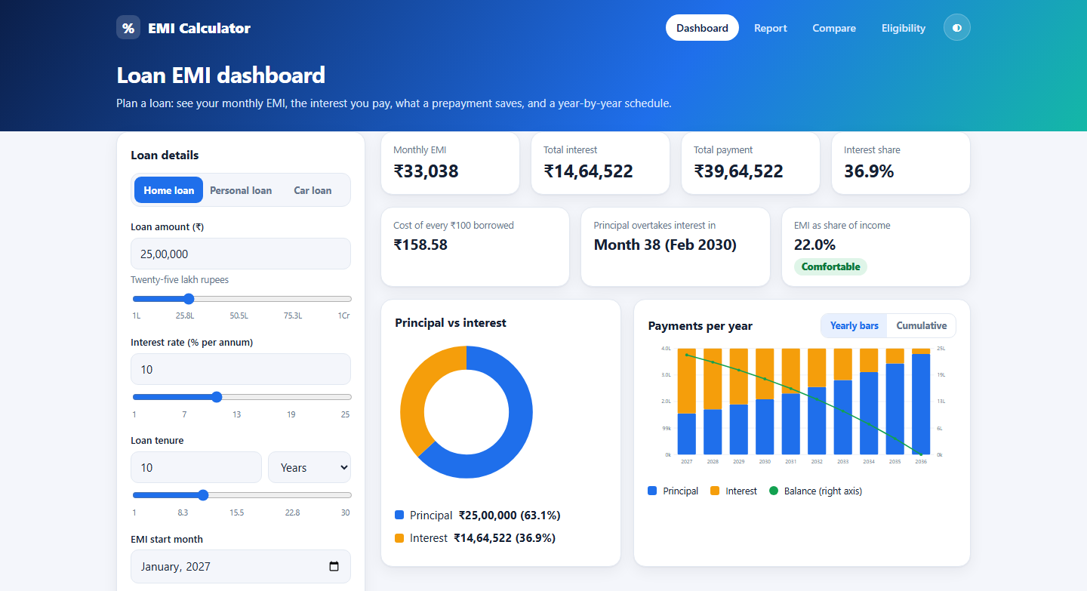
Insights and affordability put the EMI in context
04 / INSIGHTS
HOW TO USE IT
Enter your monthly income to see the EMI as a share of it, rated comfortable, stretching or risky.
WHAT YOU GET
Cost of every 100 rupees borrowed and the month principal overtakes interest show the true price of the loan.
Notes:
Comfortable is up to 30% of income, stretching up to 50%, risky above that.

Slide 7
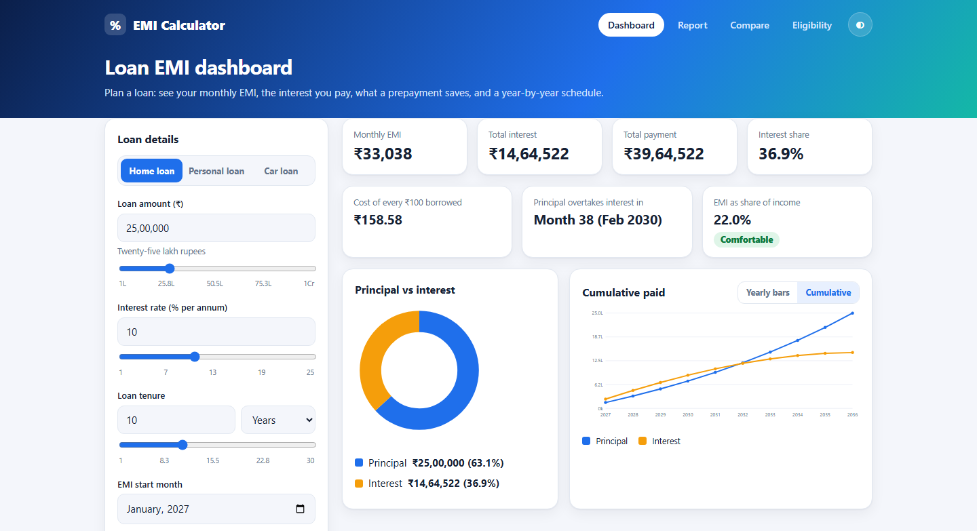
The cumulative view shows how fast the loan is really repaid
05 / CUMULATIVE CHART
HOW TO USE IT
Switch the chart from Yearly bars to Cumulative. Hover a point for the running total.
WHAT YOU GET
Two lines, principal and interest paid so far, end at the loan amount and the total interest.
Notes:
Early years pay mostly interest; the lines cross as principal repayment accelerates.

Slide 8
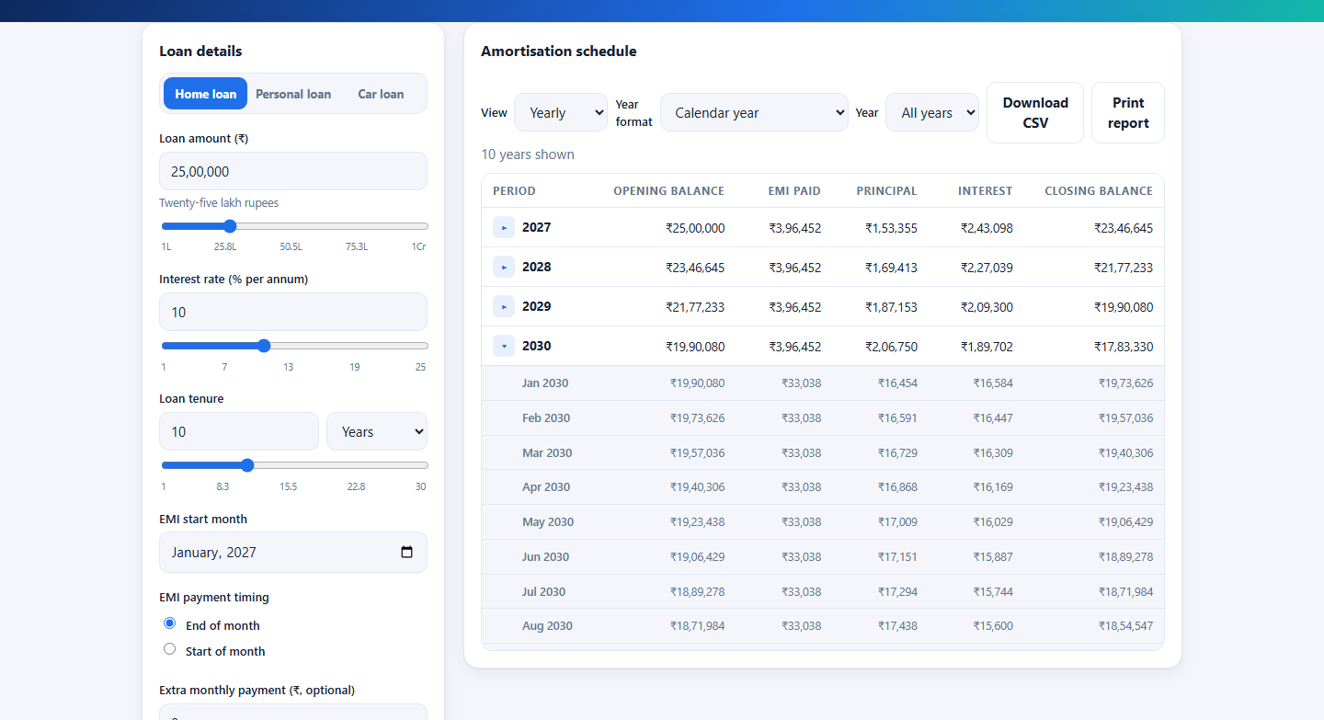
The report breaks the loan into years and months
06 / REPORT
HOW TO USE IT
Open Report. Click the arrow beside a year to expand its months, or switch between Yearly and Monthly.
WHAT YOU GET
Each row shows opening balance, EMI, principal, interest and closing balance, with totals at the bottom.
Notes:
The totals row always equals the loan amount in the principal column and the total interest in the interest column.

Slide 9
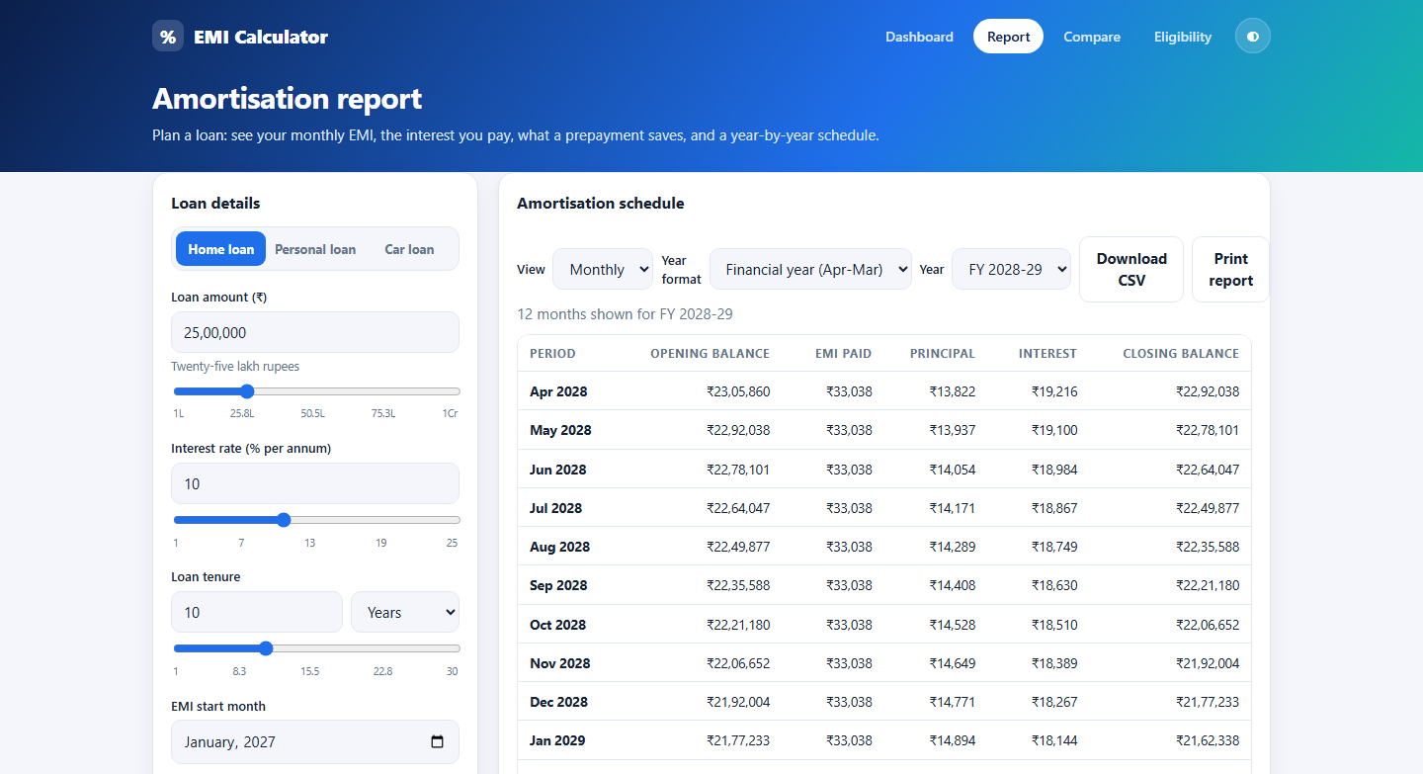
Filters match the schedule to how you account for time
07 / FINANCIAL YEAR
HOW TO USE IT
Choose Calendar or Financial year (April to March), pick a single year, then download the rows as CSV or print.
WHAT YOU GET
Financial-year totals line up with Indian accounting periods; the CSV holds exactly what is on screen.
Notes:
A loan starting in January belongs to the previous financial year for its first three months.

Slide 10
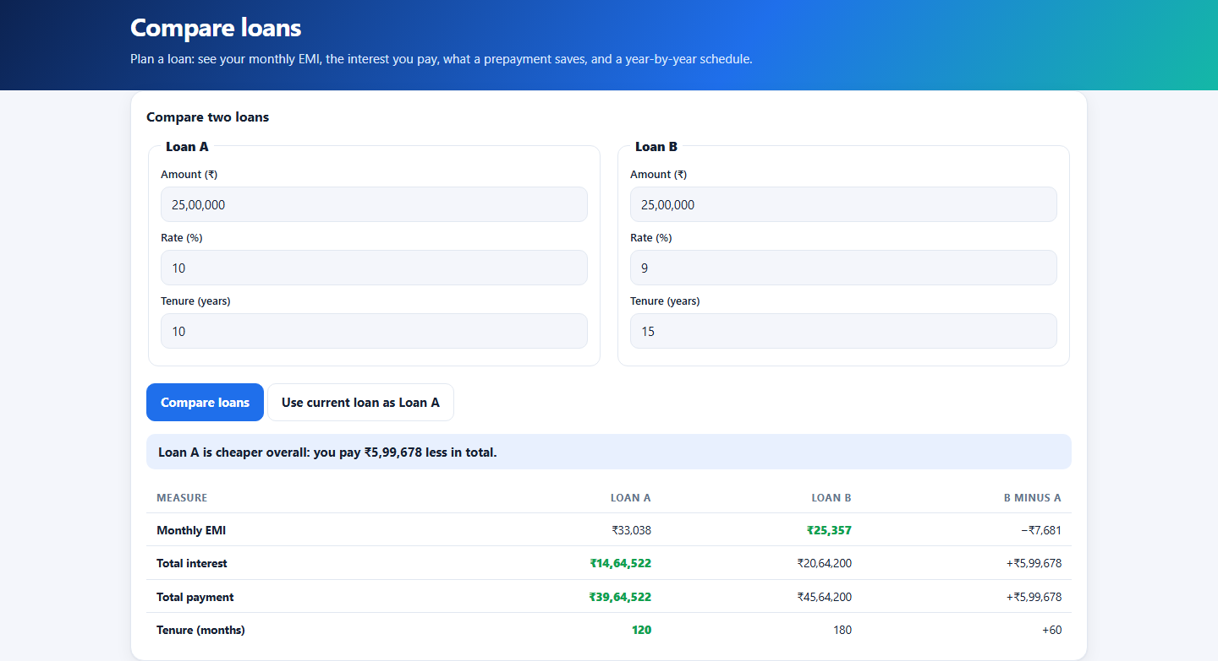
Compare two loans side by side and see which costs less
08 / COMPARE
HOW TO USE IT
Enter two loans and press Compare loans, or copy the current loan into Loan A.
WHAT YOU GET
A verdict and a B-minus-A column show the difference in EMI, interest, total payment and tenure.
Notes:
The cheaper figure in each row is highlighted in green.

Slide 11
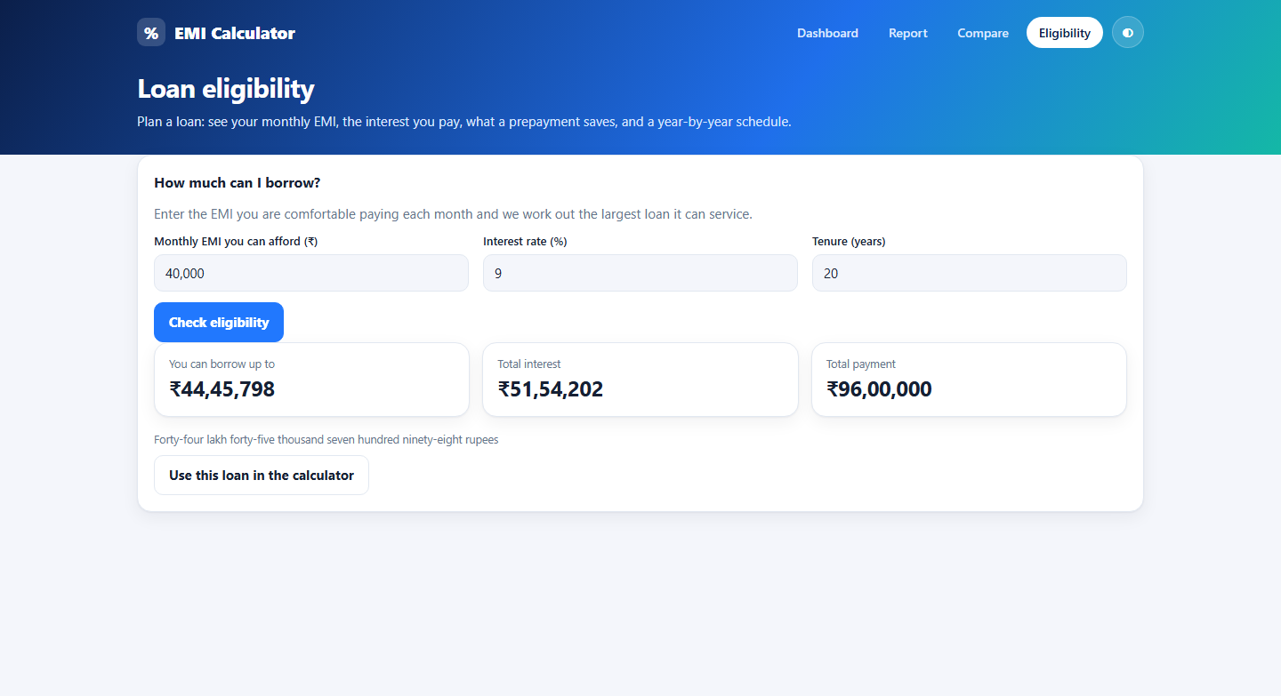
Eligibility works backwards from the EMI you can afford
09 / ELIGIBILITY
HOW TO USE IT
Enter the monthly EMI you can afford, a rate and a tenure, then press Check eligibility.
WHAT YOU GET
The largest loan it can service appears with its total cost; one click loads it into the calculator.
Notes:
40,000 a month at 9% for 20 years supports a loan of about 44.46 lakh.

Slide 12
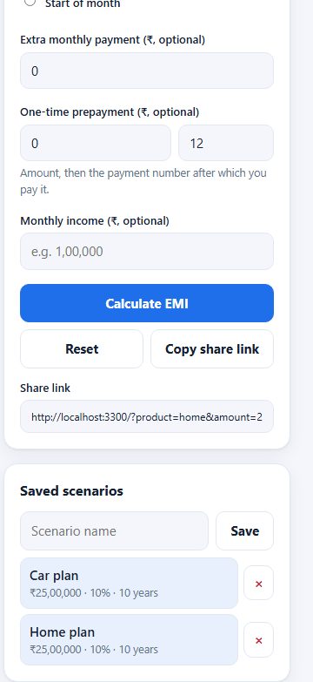
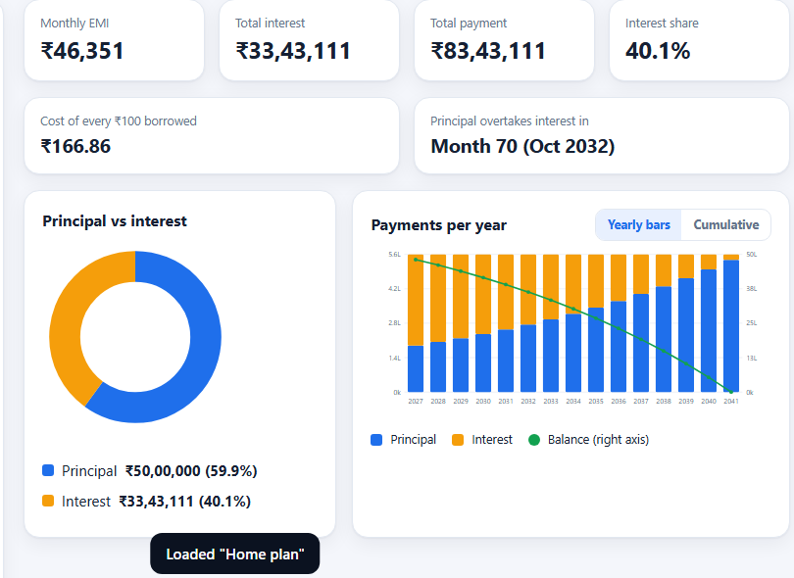
Save scenarios and share the exact loan with a link
10 / SAVED & SHARE
HOW TO USE IT
Name a scenario and press Save, or press Copy share link for a URL that restores every field.
WHAT YOU GET
Saved loans stay in your browser and reload in one click; shared links open with the same results.
Notes:
Up to eight scenarios are kept. Saving needs a name and a valid loan.

Slide 13
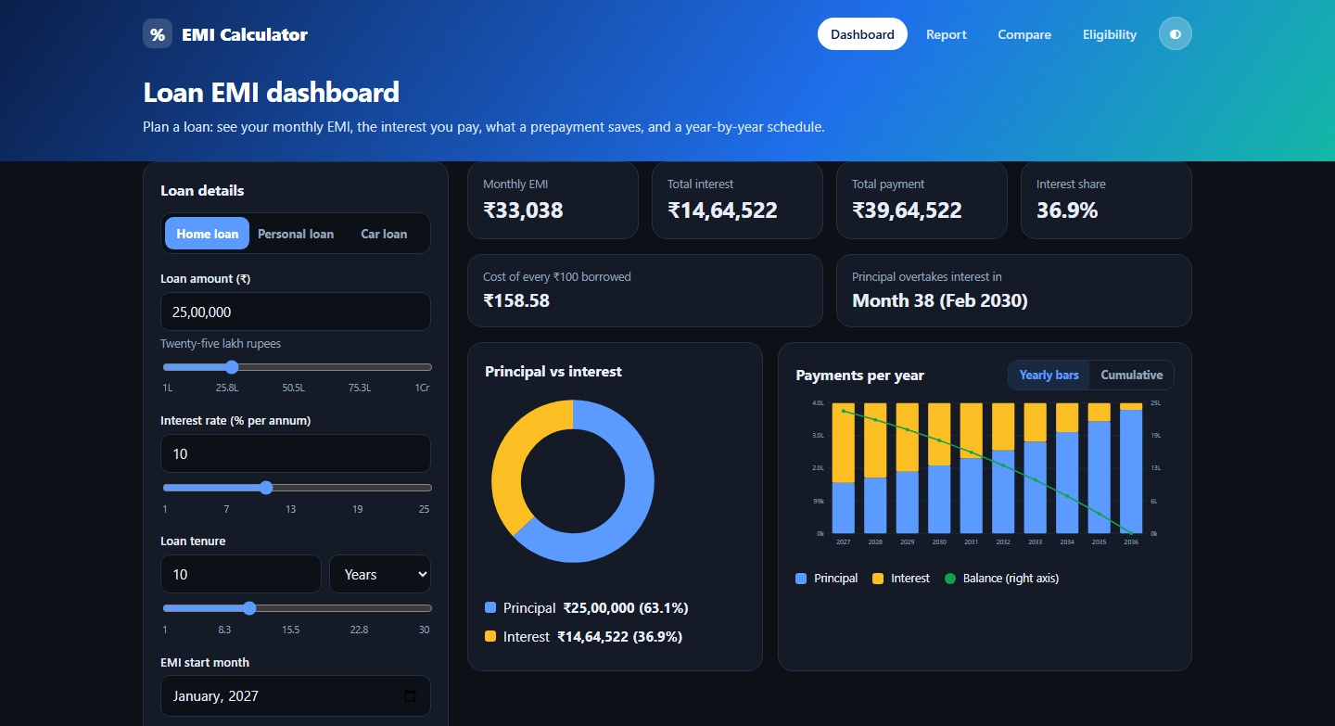
Light or dark, the numbers stay the same
11 / DARK MODE
HOW TO USE IT
Use the half-moon button in the header to switch theme. Your choice is remembered.
WHAT YOU GET
The whole app, charts included, follows the theme, and the layout adapts to narrow screens.
Notes:
The default follows the operating system setting until you choose.

Slide 14
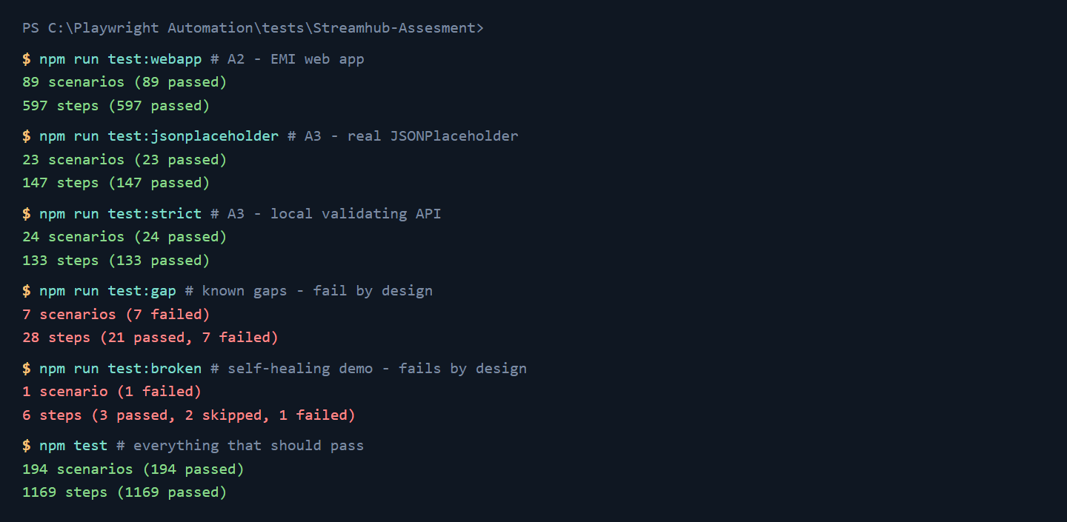
One command runs the whole test suite
12 / TEST SUITES
HOW TO USE IT
npm test runs every scenario that should pass. Each suite also has its own command, such as npm run test:webapp.
WHAT YOU GET
194 scenarios pass. The 8 that fail do so on purpose: documented API gaps and the broken-locator demo.
Notes:
Real output from the project. Red lines are intentional: test:gap documents JSONPlaceholder returning 201 for invalid input, and test:broken shows the five deliberately broken locators.

Slide 15
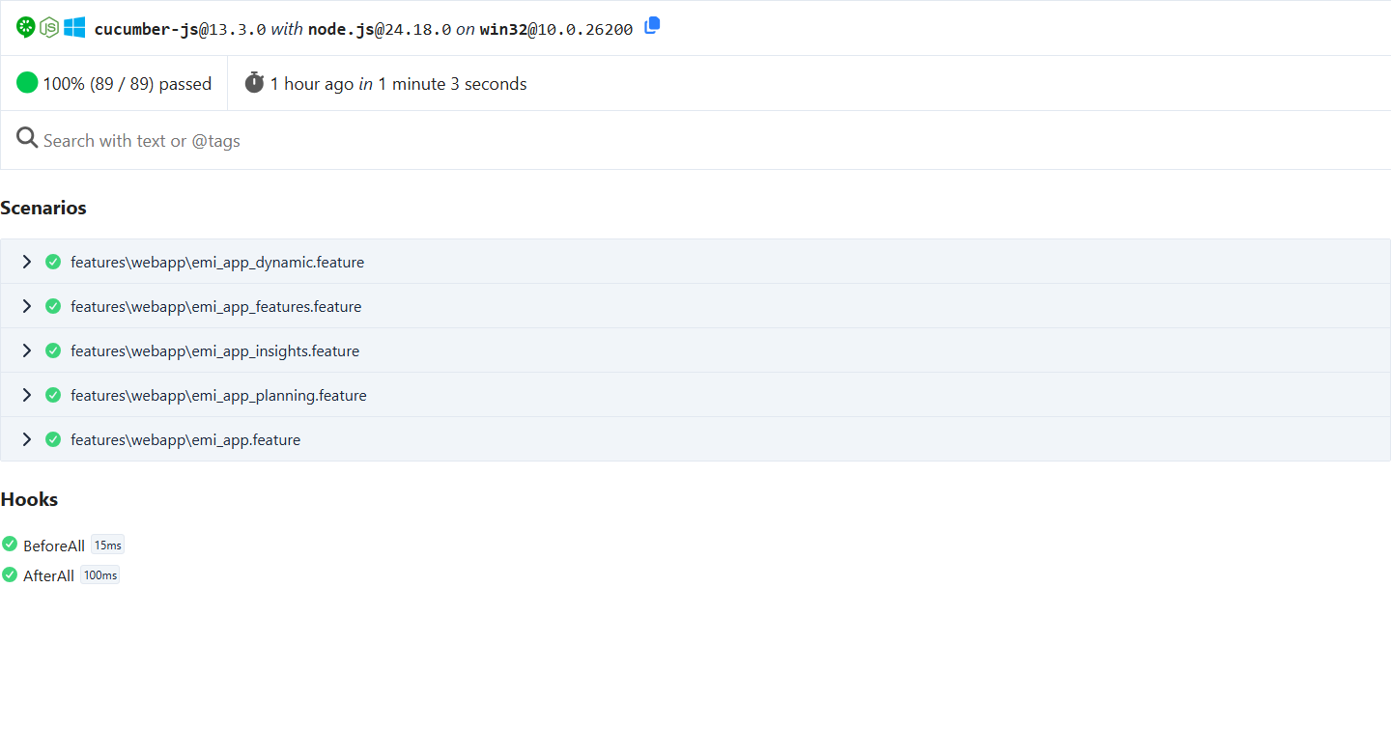
Every run produces a browsable HTML report
13 / TEST REPORT
HOW TO USE IT
Open reports/cucumber/webapp.html in a browser and expand a feature to see each scenario and step.
WHAT YOU GET
89 of 89 app scenarios pass, with a screenshot per scenario saved in reports/screenshots.
Notes:
RESULTS.md in the repository summarises all suites, and the independent expected values come from utils/emi.js, which shares no code with the app.

Slide 16
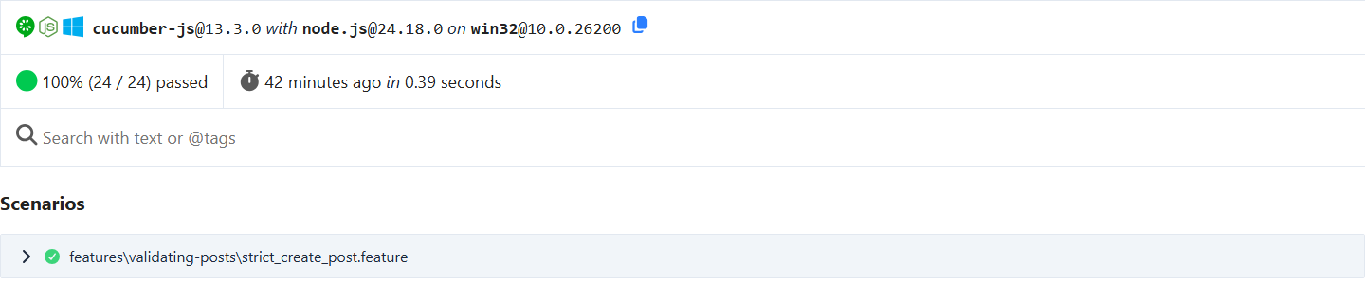
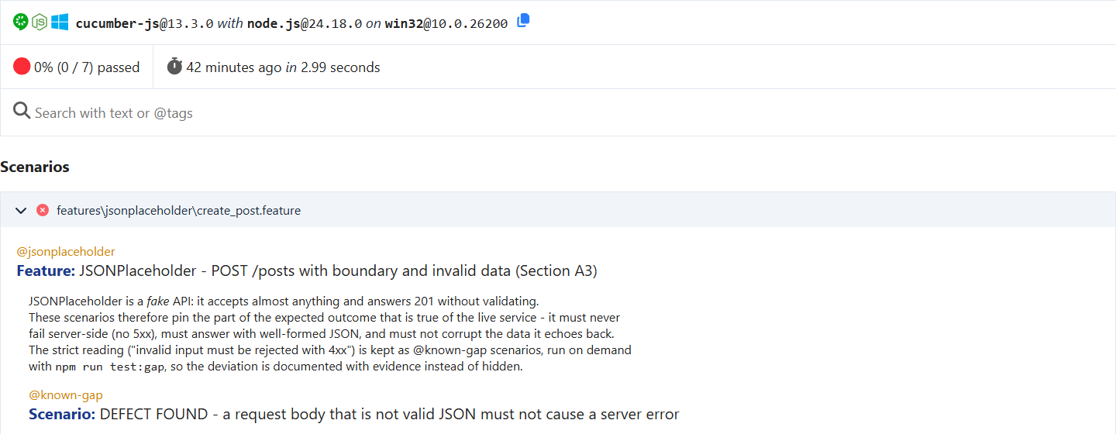
API tests prove the strict behaviour and expose gaps in JSONPlaceholder
14 / API TESTS
HOW TO USE IT
Top: 24 strict scenarios pass against a validating API. Bottom: 7 checks fail by design against the real service.
WHAT YOU GET
JSONPlaceholder answers 201 to invalid input and 500 to malformed JSON, so it cannot meet the expected outcome.
Notes:
Payloads cover very long titles, special characters and missing required fields such as userId.

Slide 17
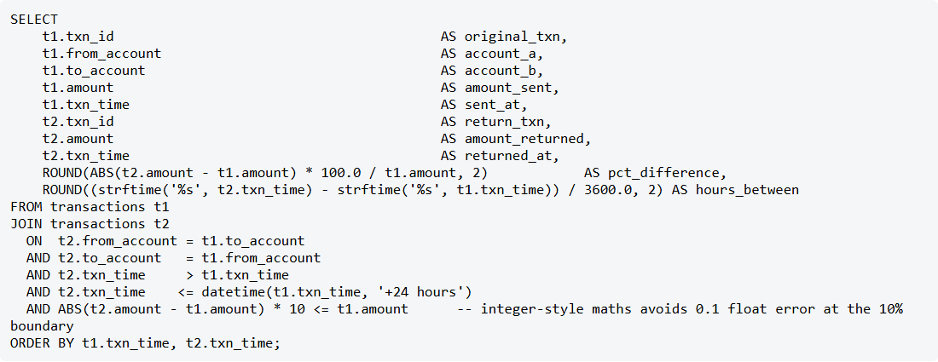
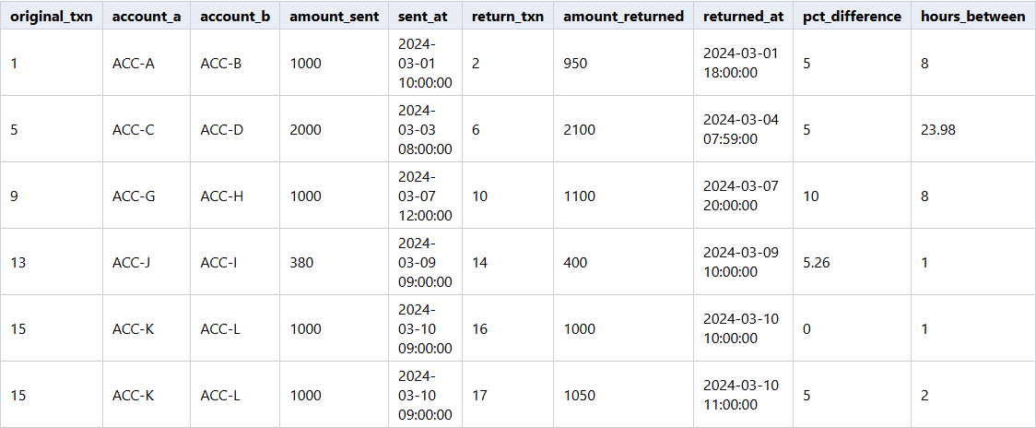
SQL finds round-trip transfers within 10% and 24 hours
15 / SQL: TRANSFERS
HOW TO USE IT
A self-join pairs each transfer with a return transfer between the same accounts in the following 24 hours.
WHAT YOU GET
6 pairs are found, including exactly +10% and 23h59m, while 12% and 24h01m are correctly excluded.
Notes:
Schema and sample data are in sql/01_schema.sql and sql/02_sample_data.sql.

Slide 18
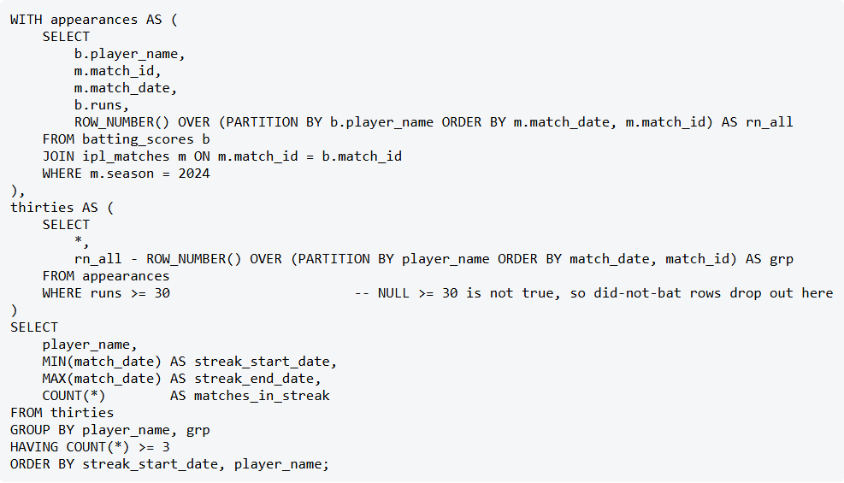
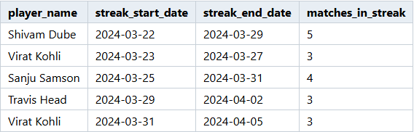
SQL finds players with 30+ runs in three matches in a row
16 / SQL: IPL STREAKS
HOW TO USE IT
Two ROW_NUMBER() columns group consecutive 30+ innings. Groups of three or more are streaks.
WHAT YOU GET
5 streaks start on the dates shown. A did-not-bat or a 29 breaks a run, and 2023 data is excluded.
Notes:
The technique is called gaps and islands.

Slide 19
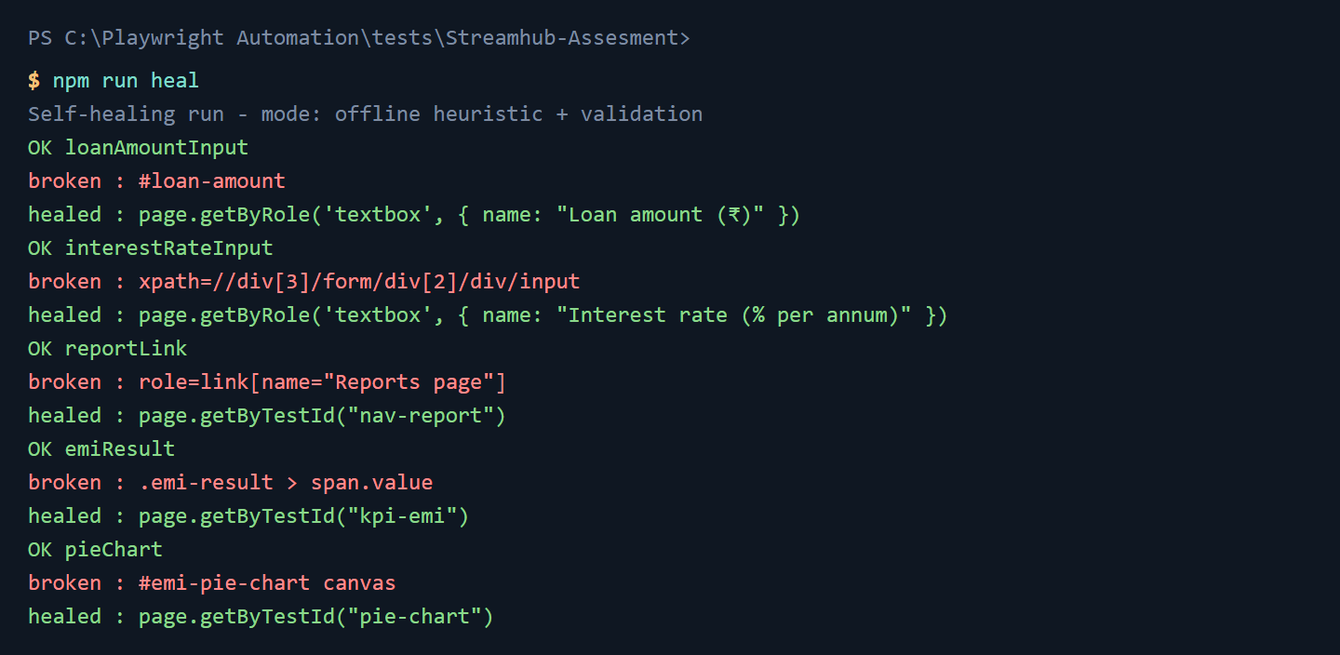
AI self-healing proposes fixes for broken locators
17 / SELF-HEALING
HOW TO USE IT
Five locators are deliberately broken. npm run heal finds candidates and validates each one in a real browser.
WHAT YOU GET
All five heal to role, label or test-id locators. The fix is reported for review, never applied automatically.
Notes:
The language-model path is implemented but was not run without an API key; npm run heal -- --prompt prints the exact prompt it would send.

Slide 20
Run it yourself in five minutes
GET STARTED
README.md
$ npm install
$ npx playwright install chromium
$ npm run app:start # app at localhost:3300
$ npm run test:webapp # 89 scenarios
$ npm run test:jsonplaceholder
$ npm run test:strict # 24 scenarios
$ npm run sql # both queries
$ npm run heal # self-healing
$ npm run results # rebuild RESULTS.md
setup, how to run, architecture, reflection
RESULTS.md
every result number, plus screenshots
docs/REQUIREMENTS_CHECKLIST.md
the brief, line by line
reports/
HTML reports, screenshots, SQL output
Notes:
Closing. Everything needed to reproduce the results is in the repository; RESULTS.md and docs/REQUIREMENTS_CHECKLIST.md are the quickest places to verify the work.

